Slide 1
Ontology Driven Data Collection for EuPathDB
Jie Zheng
Center for Bioinformatics
University of Pennsylvania Perelman School of Medicine
2011 ICBO OBI Tutorial

Slide 2
Issues Associated with Data Collection
Heterogeneity of free text
Difficulty in data integration, requires human intervention
Complex queries are limited

Slide 3
GenBank Sequence Data

Slide 4
What will be covered in this use case
How to design a data submission form based on an ontology model
Example: Form to collect sequence data and information on isolates of pathogens
How to reduce user effort in submission using restrictions defined in an ontology
Example: Use of the Ontology for Parasite Lifecycle (OPL) in the annotation of Gene Manipulation and Phenotype of Parasites submission form

Slide 5
Ontology Based Model
Data or information for collection
Identify ontology parent classes of data or information
Apply the ontology defined relations to reveal the interconnection of data or information collected
The model will help
Clarify what data or information will be collected
Identify the data or information needed to be collected
Example:
Isolate submission form for EuPathDB
Project with Omar Harb and Chris Stoeckert

Slide 6
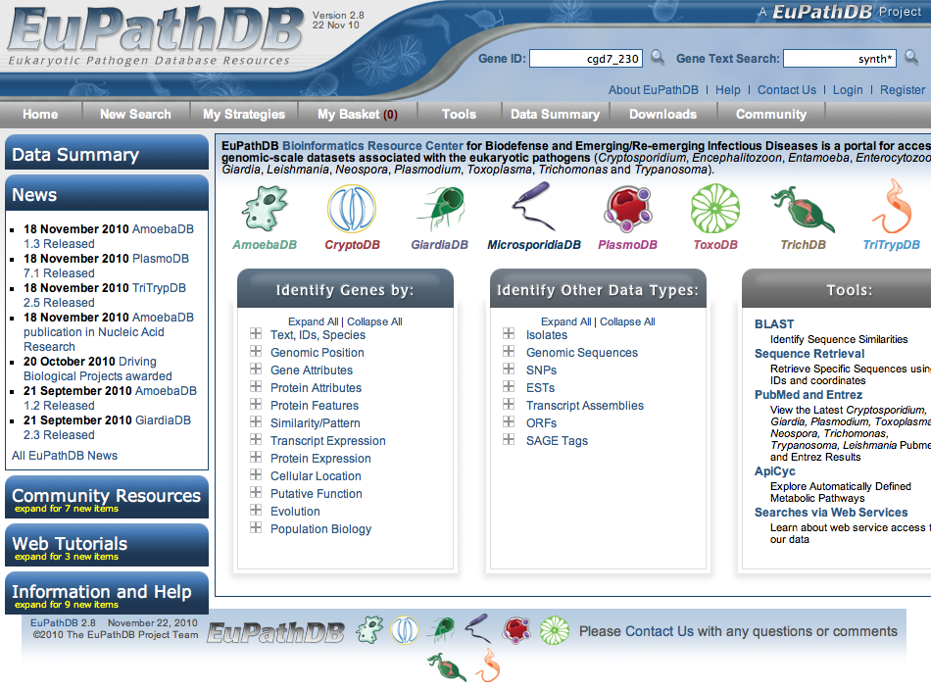
EuPathDB
One of five National Bioinformatics Resources Centers (BRCs) supported by NIH/NIAID, containing protozoan parasite genomic and functional genomic data
Mission is to enable researchers worldwide to identify and prioritize candidate targets for further research in the lab, field and clinic.
EuPathDB: a portal to
eukaryotic pathogen
databases. Aurrecoechea C, et al.
Nucleic Acids Res. 2010

Slide 7
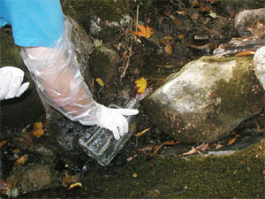
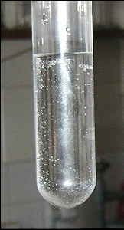
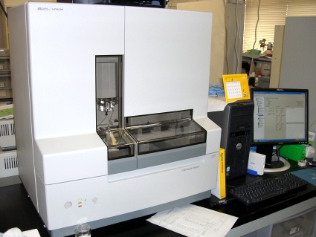
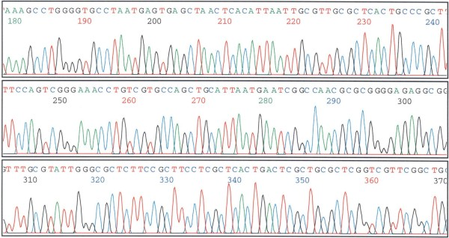
Isolate Data
Isolate: microorganisms (parasites) isolated froman environmental source (e.g.pool) or host material (e.g. human blood)
The genetic characteristics of an isolate can be identified through agenotyping assay
collect
specimen
Sequencing
assay
parasite
Which type of parasite(e.g. species, subtype, strain, genotype) wasin the isolate specimen?

Slide 8
Current Issues of Isolate Data
Need to import and integrate datasets from GenBank
GenBankdoes not specify needed metadata for isolates
Manual curation required
Harmonize: enable host queries: Human-> Homo sapiens
Deconvolute descriptions in free text: isolated from storm waters, isolated from Homo sapiens patient infected with HIV
Notes:
Completeness of isolate data depending on submitter

Slide 9
Isolate Submission Form
Isolate information
Target isolate information
Geographic location
Source organism samples information
or Environmental samples information
Sequence information
These data are important for parasite epidemiology.

Slide 10
Ontology Based Model
Identify ontology parent classes of data or information
Apply the ontology defined relations to reveal the interconnection of data or information collected

Slide 11
Main Components of OBI and Their Relations
site
is_a independent
_continuant
located in
has specified input
material entity
is_a independent
_continuant
planned process
is_a occurrent
has specified output
inheres in
is about
is about
information content entity (ICE)
quality
is_a dependent_
continuant
is about

Slide 12
Ontology Based Model
ICE
Isolate ID
denotes
Process
ICE
is about
Date Collected
OBI:
Specimen
Creation
Process
site
Geographic Location
(Country, State, etc.)
has_specified_input
Isolate
Environmental
Source
Located_in
qualities of host organism: sex, age, etc.
OBI:
Specimen
(Isolate
Specimen)
has_specified_output
material
entity
Source
has_specified_input
other inputs:
PCR primers
Host
has_specified_input
organism
Isolate Species
has_part
OBI: Assay
(Sequencing
Assay)
other
information:
Subtype, etc
Product Name
denotes
Protein
ICE
dependent
continuant
Nucleotide
Sequence
inheres in
DNA
derives_from
ICE
Sequence
has_specified_output
is about
Notes:
Process central ontology, process will link the material entities

Slide 13
Isolate Submission Form
Isolate submission form
Support multiple sequences submission to GenBank with a parser
Notes:
Isolate ID: not clear what it refers to
Specimen id
target isolate id
sequence id (which it is in EuPathDB)
Sequence description: (required by GenBank)
complete sequence
partial sequence
partial cds
unknown

Slide 14
Ontology Chosen for Annotation
OBO foundry library ontologies
Interoperable
Easy for integration
Community preferred/well-defined ontologies

Slide 15
Ontology Selection
15
Notes:
Isolate ID: not clear what it refers to
Specimen id
target isolate id
sequence id (which it is in EuPathDB)
Sequence description: (required by GenBank)
complete sequence
partial sequence
partial cds
unknown
15

Slide 16
Reduce User’s Efforts in Submission using Restrictions Defined in Ontology
Limit ontology terms used in annotation based on the restrictions of terms
Example:
Ontology for Parasite Lifecycle (OPL) used in the annotation of Gene Manipulation and Phenotype Data
Project with Omar Harb and Chris Stoeckert

Slide 17
Genetic Manipulation and Phenotype Submission Form
Genetic Manipulation
Mutation method
Mutation type (effect on gene function)
Phenotype data – impact of genetic manipulation on four possible observed features:
Quality of the organism
Cellular location of gene product
Molecular function of gene product
Biological process of gene product
Lifecycle stage: phenotype observed generally associated with a specific parasite lifecycle stage
(eg. lethal during bloodstream stage)
Notes:
identifying novel intervention targets
localization of a parasite within its host at each lifecycle stage
host and vector information of parasites
several parasitic organism genomes, namely Trypanosomabrucei, Trypanosomacruzi, Leishmania major, Plasmodium falciparum, and Schistosomamansoni.
Since the majority of experiments carried out in parasitic organisms are done in a single lifecycle stage, it is important to annotate phenotype data with this information to enable users to analyze the data appropriately.
lethal during bloodstream stage

Slide 18
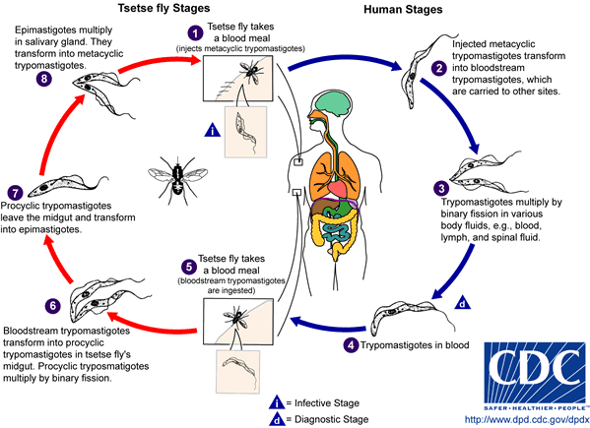
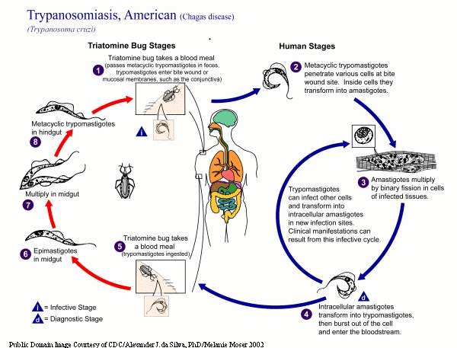
Parasite Lifecycle Stage
Complexity – parasites may have multiple hosts and lifecycle stages which differ between parasite species
Example: Trypanosomabrucei(causes African sleeping sickness), Trypanosoma cruzi (causes Chagas disease)
Trypanosoma brucei
Trypanosoma cruzi
Notes:
There are many types of parasites, and each one has variations to its life cycle. There are, however, similarities among the life cycles of all parasites. The one thing that all parasites have in common is that they are opportunistic organisms that live off the blood of other living organisms. Parasites are dangerous for two reasons. The first is that they can infiltrate the host to the point of consuming all of the body's food, clogging vessels or organs and killing the host, and the other is that they can pass deadly diseases to host organisms. Read more: Life Cycle of a Parasite | eHow.comhttp://www.ehow.com/about_5339802_life-cycle-parasite.html#ixzz1S1N345mM
http://www.dpd.cdc.gov/dpdx/HTML/TrypanosomiasisAfrican.htm
During a blood meal on the mammalian host, an infected tsetse fly (genus Glossina) injects metacyclictrypomastigotes into skin tissue. The parasites enter the lymphatic system and pass into the bloodstream (1) . Inside the host, they transform into bloodstream trypomastigotes (2), are carried to other sites throughout the body, reach other blood fluids (e.g., lymph, spinal fluid), and continue the replication by binary fission (3). The entire life cycle of African Trypanosomes is represented by extracellular stages. The tsetse fly becomes infected with bloodstream trypomastigotes when taking a blood meal on an infected mammalian host (4,5). In the fly’s midgut, the parasites transform into procyclictrypomastigotes, multiply by binary fission (6), leave the midgut, and transform into epimastigotes (7). The epimastigotes reach the fly’s salivary glands and continue multiplication by binary fission (8). The cycle in the fly takes approximately 3 weeks. Humans are the main reservoir for Trypanosomabruceigambiense, but this species can also be found in animals. Wild game animals are the main reservoir of T. b. rhodesiense.
To illustrate the complexity of parasite lifecycle stages we consider theTrypanosomacruziparasite, which has three stages, namely amastigote, epimastigote, and trypomastigote. The amastigote is an intracellular form that is found in humans/vertebrate hosts of the parasite, the epimastigote is found in the midgut of an insect vector and the trypomastigote is found in the bloodstream of a vertebrate host. Further, the similar lifecycle stage in different organisms may have different locations and vectors. For example, the epimastigote stage of T. cruzi occurs in the midgut of the triatomine kissing bug, but in T. brucei it occurs in the salivary gland of the tsetse fly, Glossinamorsitans.

Slide 19
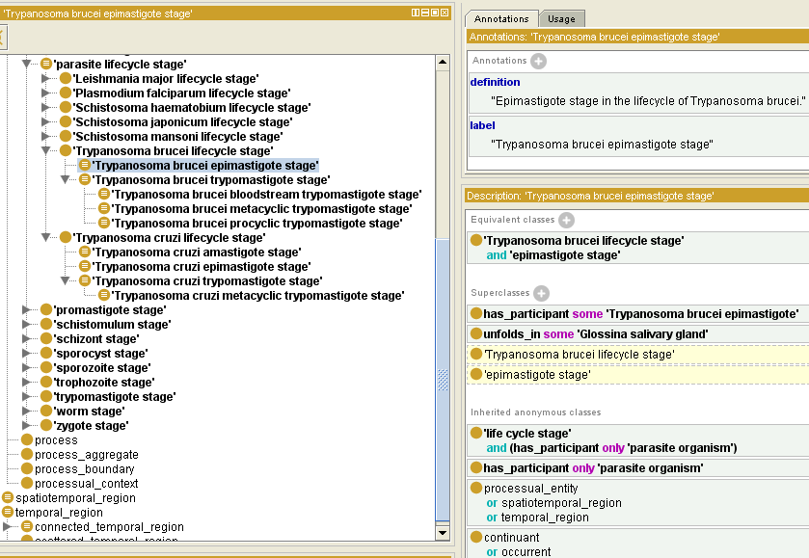
OPL: Priti Parikh, JieZheng, Flora Logan-Klumper, Christos Louis, Christian Stoeckert, AmitSheth, and Satya S. Sahoo
Notes:
Around 300 terms, parasite lifecycle stage, where it takes place, vector and host of specific parasite, etc.

Slide 20
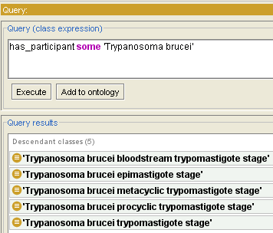
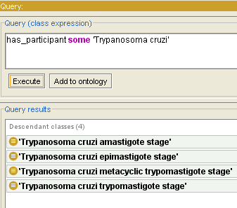
Lifecycle Stages for a Specific Parasite
Over 100 terms -> less than 10 terms
Trypanosoma brucei
Trypanosoma cruzi

Slide 21
Summary – lessons from this use case
How to design a data collection form based on an ontology model
How to choose ontologies to be used for annotations collected in the forms
Notes:
EupathDB, data we want to collect and issues we have now

Slide 22
Questions?

